Slide 1
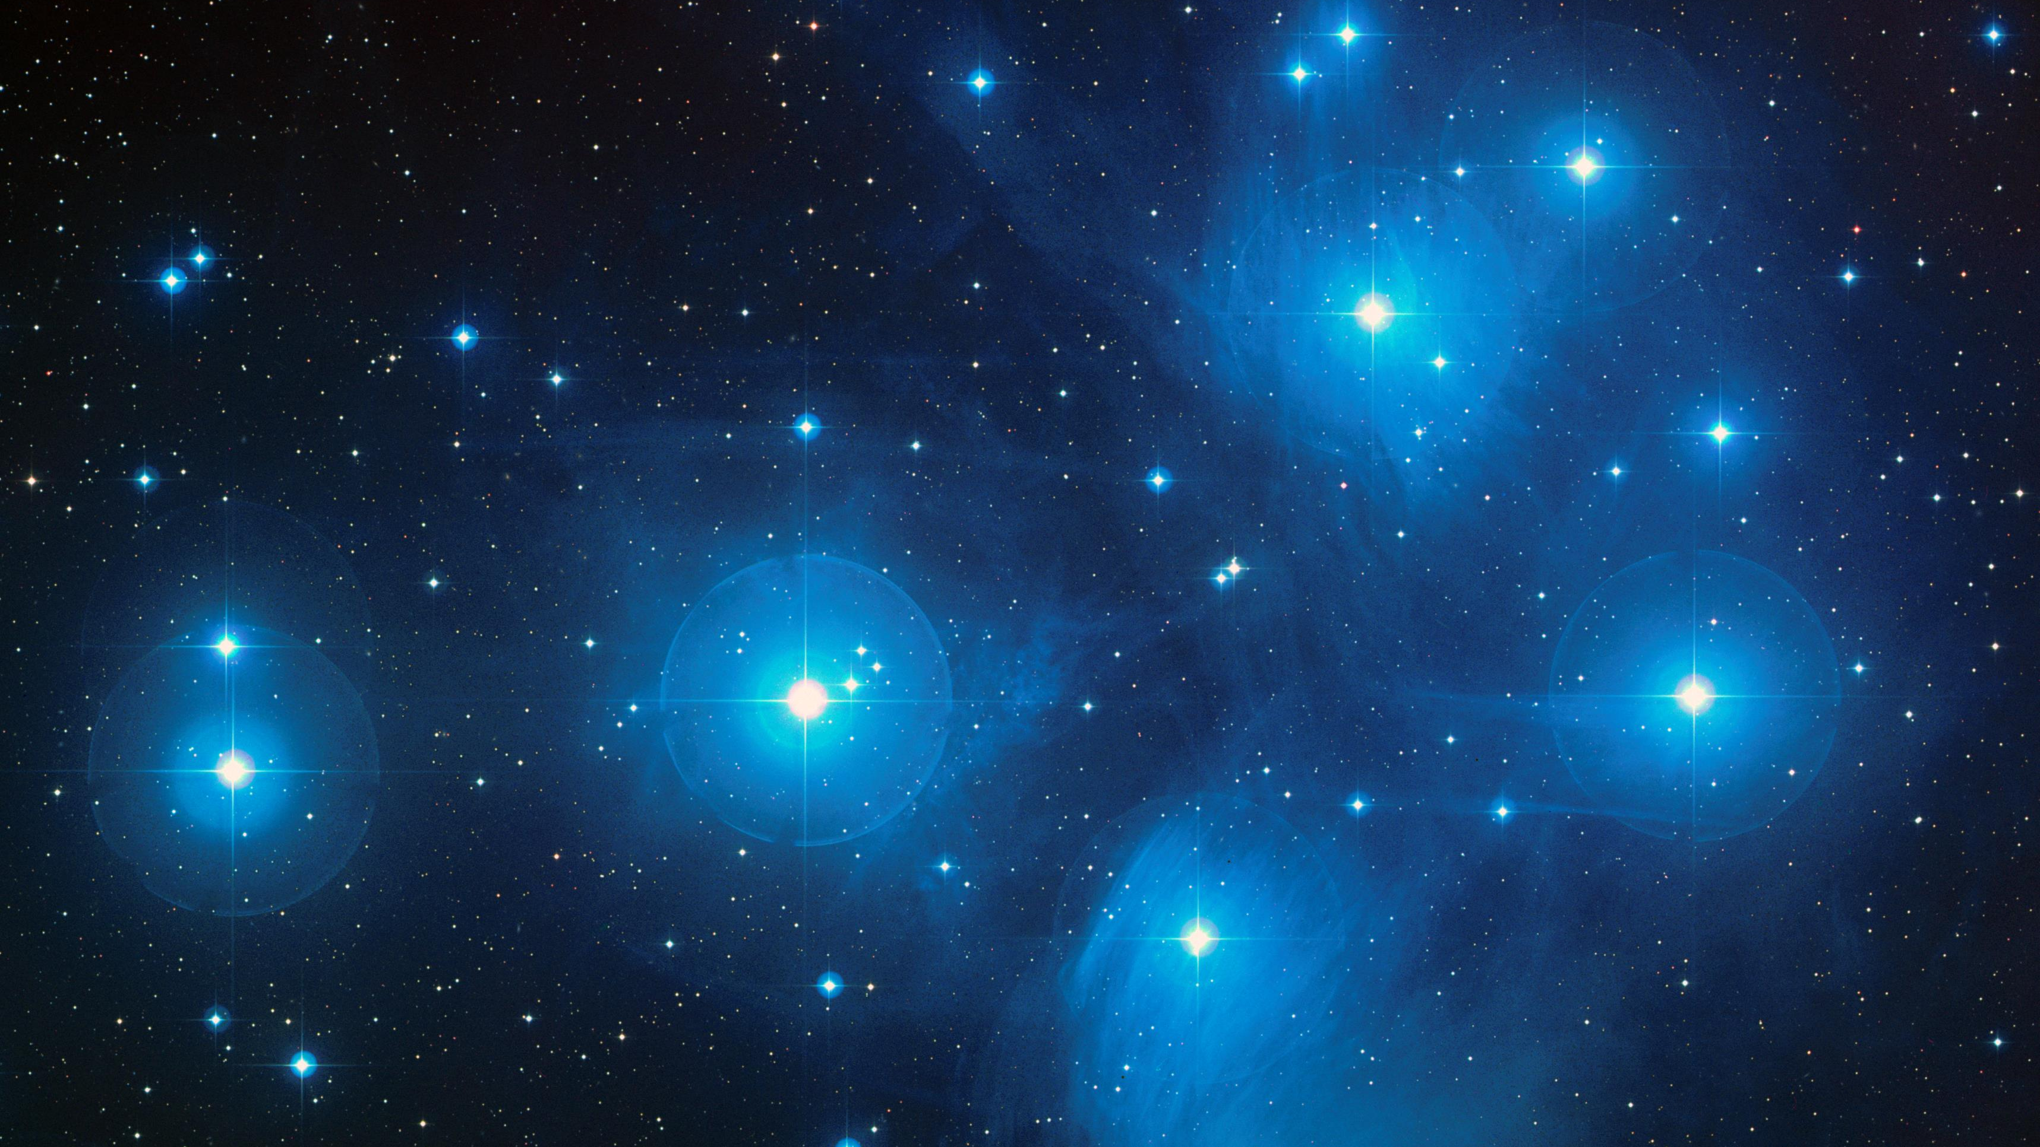
Cultural Understandings of The Pleiades
Comparing the stories and folklore of
Ancient Israelite/Jewish and
Cherokee (TsaLaGi) peoples
A presentation for Astronomy-The Solar System
At Tohono O’odham Community College
by James M. Branum

Slide 2
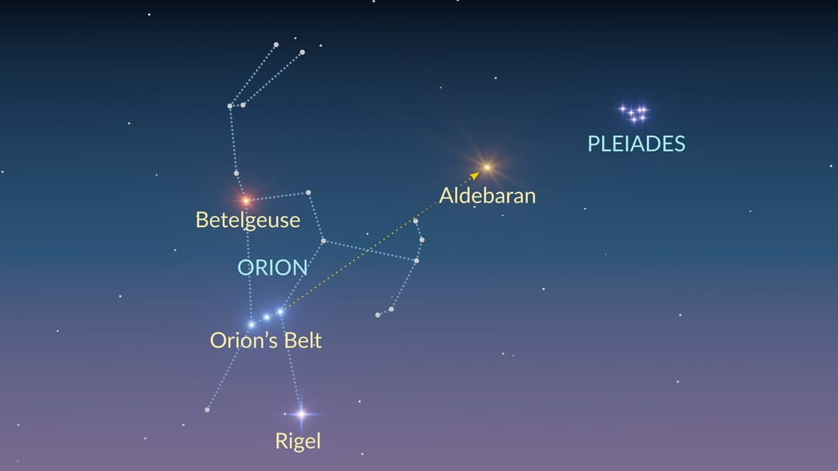
Pleiades is a star-cluster that is visible from almost all parts of the Earth for at least part of the year. Thanks to its brightness, it has long attracted interest by human societies.
In this presentation, I will be exploring two sets of these stories, from the Jewish and Cherokee traditions. I have chosen these two traditions due to these two traditions being parts of my identity, but there are many other world traditions that tell stories about these stars.

Slide 3
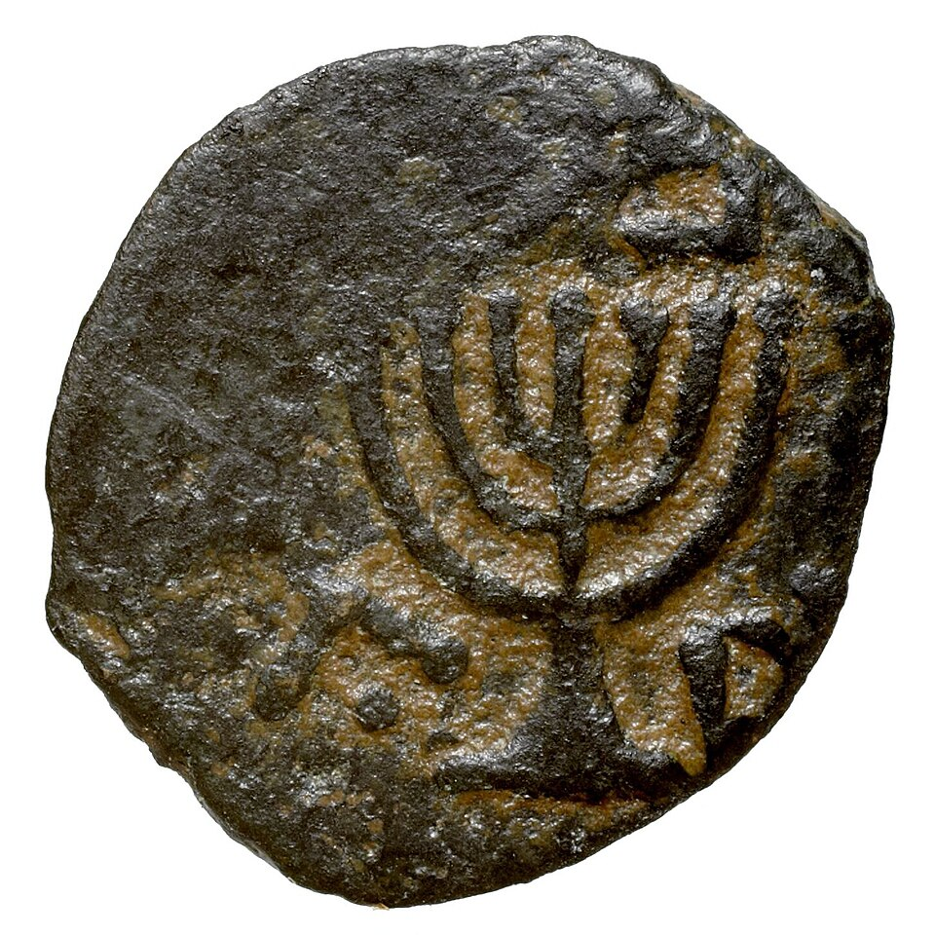
Pleiades in the Ancient Israelite/Jewish Tradition
In the Tanakh (Jewish Bible), Pleiades are mentioned in three texts (Amos 5:8, Job 9:9, and Job 38:31), all of which depict Pleiades alongside Orion in a way that hints at the earlier polytheistic roots of the tradition, but also at the monotheistic norms of the time that these texts were written (since the god of the Israelites is depicted as having supremacy over these personified constellations.
In the Babylonian Talmud (a later collection of writings from the Rabbinic tradition), Pleaides is spoken of in more detail, alongside other constellations. This treatment is likely due to the evolving understandings of ancient Astronomy by the Jewish people in their encounters with their neighbors.
The name of the Pleiades in Hebrew is: כימה (kimah).

Slide 4
Amos 5:8
עֹשֵׂ֨ה כִימָ֜ה וּכְסִ֗יל וְהֹפֵ֤ךְ לַבֹּ֙קֶר֙ צַלְמָ֔וֶת וְי֖וֹם לַ֣יְלָה הֶחְשִׁ֑יךְ הַקּוֹרֵ֣א לְמֵֽי־הַיָּ֗ם וַֽיִּשְׁפְּכֵ֛ם עַל־פְּנֵ֥י הָאָ֖רֶץ יְהֹוָ֥ה שְׁמֽוֹ׃
Who made the Pleiades and Orion,
Who turns deep darkness into dawn
And darkens day into night,
Who summons the waters of the sea
And pours them out upon the earth—
Whose name is GOD
Job 9:9
עֹֽשֶׂה־עָ֭שׁ כְּסִ֥יל וְכִימָ֗ה וְחַדְרֵ֥י תֵמָֽן׃
Who made the Bear and Orion, Pleiades, and the chambers of the south wind;
Job 38:31
הַֽ֭תְקַשֵּׁר מַעֲדַנּ֣וֹת כִּימָ֑ה אֽוֹ־מֹשְׁכ֖וֹת כְּסִ֣יל תְּפַתֵּֽחַ׃
Can you tie cords to Pleiades Or undo the reins of Orion?
Pleiades in the
Tanakh
ca. 750 BCE (Book of Amos)
ca. 540-330 BCE (Book of Job)
These texts were taken from the Revised JPS Translation 2023, via Sefaria.org.

Slide 5
From Berakhot 58b:
. . . On the subject of stars, the Gemara notes that Shmuel raised a contradiction between the implications of two verses with regard to constellations. On the one hand it is written: “Who makes Ursa Major, Orion, and Pleiades, and the chambers of the south” (Job 9:9); Orion precedes Pleiades. And on the other hand it is written: “He Who makes Pleiades and Orion” (Amos 5:8); Pleiades precedes Orion. So how is this reconciled? The Gemara replies: Were it not for Orion’s heat, the universe could not exist because of the cold of Pleiades; and conversely, were it not for the cold of Pleiades, the universe could not exist because of the heat of Orion.
And we learned a tradition that if the tail of the constellation Scorpio did not rest in the River of Fire, anyone stung by a scorpion would not survive. And that is what the All-Merciful said to Job of the relationship between heat and cold among the stars: “Can you bind the chains of the Pleiades or loosen the bands of Orion?” (Job 38:31); God alternates intensifying the power of different constellations in order to raise or lower the temperature.
With regard to Pleiades, the Gemara asks: What is Pleiades [Kima]? Why is it called by that name? Shmuel said: Because it is approximately a hundred [keme’a] stars, as that is the number of stars in that constellation; some say that they are concentrated and some say that they are dispersed.
With regard to the verse: “Who makes Ursa Major, Orion, and Pleiades” (Job 9:9), the Gemara asks: What is Ursa Major [Ash]? Rav Yehuda said: It is the star called Yota. This name was unfamiliar as well, so the Gemara asks: What is Yota? There is disagreement; some say that Yota is the group of stars comprising the tail of Aries, while others say that Yota belongs to the head of Taurus. The Gemara concludes: And it stands to reason in accordance with the opinion of the one who said that Yota is the group of stars comprising the tail of Aries, as it is written: “Or can you guide Ursa Major with her sons?” (Job 38:32); apparently it was incomplete and the tail appears.
Pleiades in the Babylonian
Talmud
(circa 450-550 CE)
Translation from The William Davidson Talmud (Koren-Steinsaltz), courtesy of Sefaria.org.

Slide 6
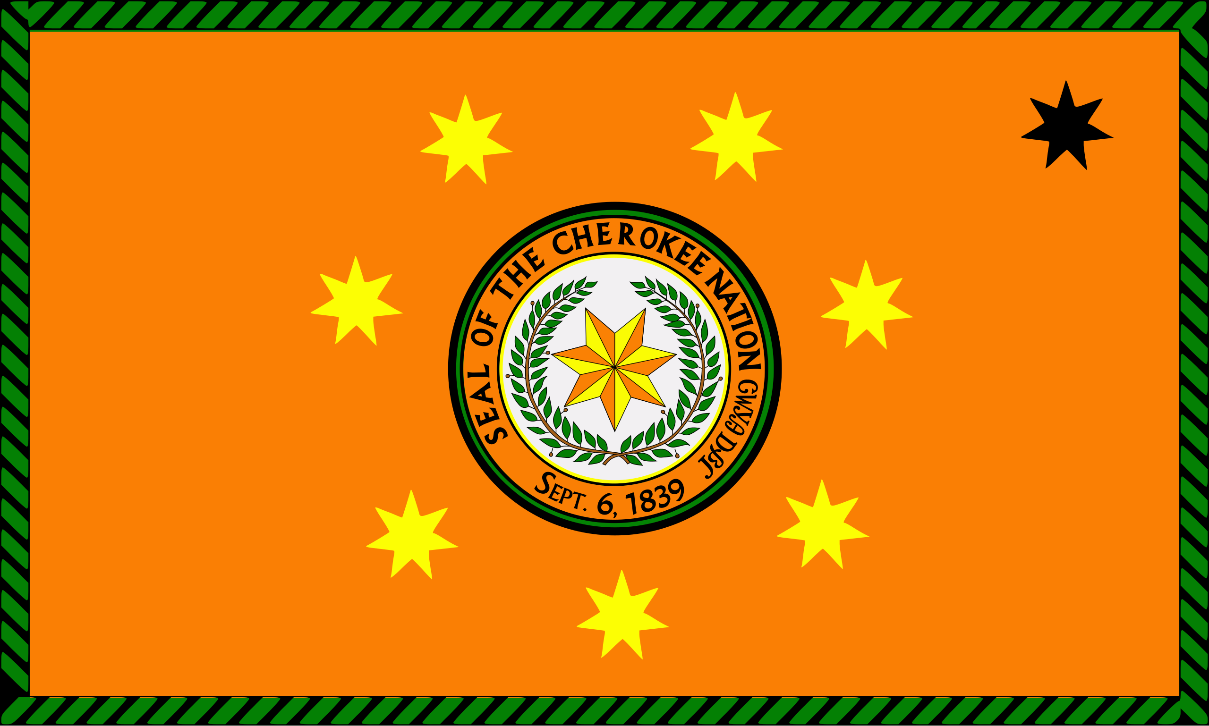
Pleiades in the TsaLaGi (Cherokee) Tradition
The Pleiades in the Cherokee tradition are called ᎠᏂᏧᏣ (Anitsutsa), which means "The boys."
They get this name from the following very old story (the details of the story vary by who is telling it):

Slide 7
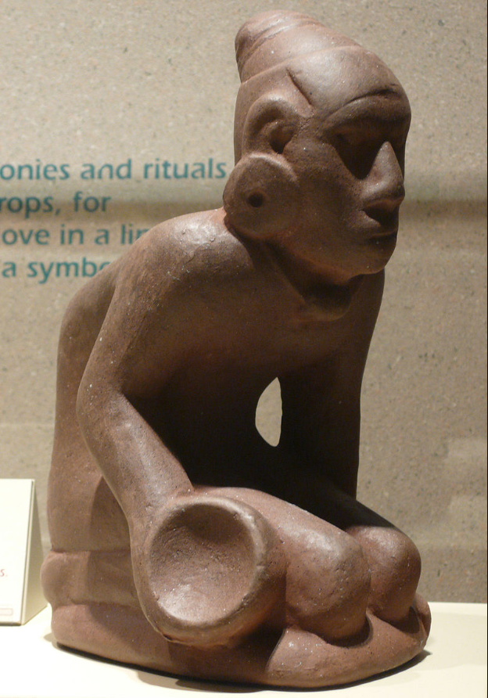
The Cherokee Story of the Seven Brothers
Seven Cherokee boys were fanatics of the game of ᎦᏓᏳᏥ Gatayusti (today known as Chunkey), which involves rolling stones and then either throwing spears or using bent sticks to interact with them.
These seven boys were so engrossed in their game, playing all hours of the day, that they were neglecting their work tending the corn fields.
“Chunkey player”
Found in Muskogee County, Oklahoma, believed to have originated at Kahokia.

Slide 8
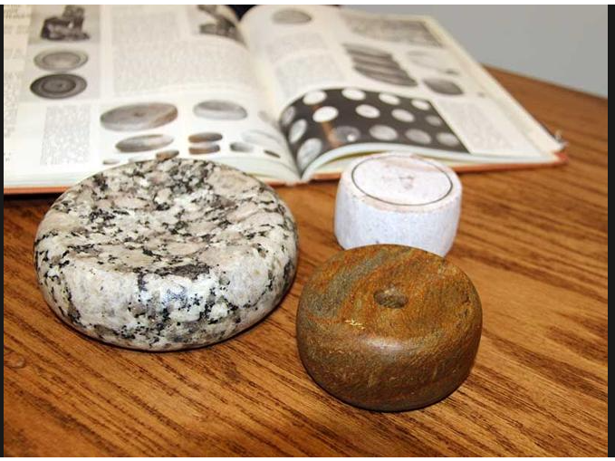
The mothers of the seven boys were not happy with their sons and decided to teach them a lesson they wouldn’t soon forget.
They took their Chunkey stones, boiled them with corn, and then fed them to the boys as punishment.
Modern Chunkey stones

Slide 9

The boys were furious at what their mothers had done and told them, “you’ll never see us again.”
The boys then started dancing in a circular pattern (a dance that would later be called a “feather dance”), and as they danced they began to rise into the sky.
They kept rising higher and higher, until one of the mothers used a Chunkey stick to pull her son back to the earth, but he fell so hard that he disappeared into the earth. The rest of the boys continued into the heavens, eventually becoming the six visible stars of Pleiades, while the 7th boy is remembered by a ceremonial pine that was planted in his memory.
The name “Anitsutsa” (the boys) stuck as the name for the Pleiades in the Cherokee language.
Modern Cherokees playing Chunkey
ᎠᏂᏧᏣ

Slide 10


Intertribal Comparisons
The Cherokee story is interestingly very similar to stories told by other Indigenous American peoples, most notably that of the Haudenosaunee (Iroquois) confederacy. This is especially noteworthy because the Cherokee language is part of the Iroquoian family of languages, which suggests the story might have roots in common ancestors of these peoples.
Caddo and Ojibwe peoples also have stories very similar to those of the Cherokee and Iroquois, involving lazy boys who ascend to the heavens by dancing to avoid work.

Slide 11

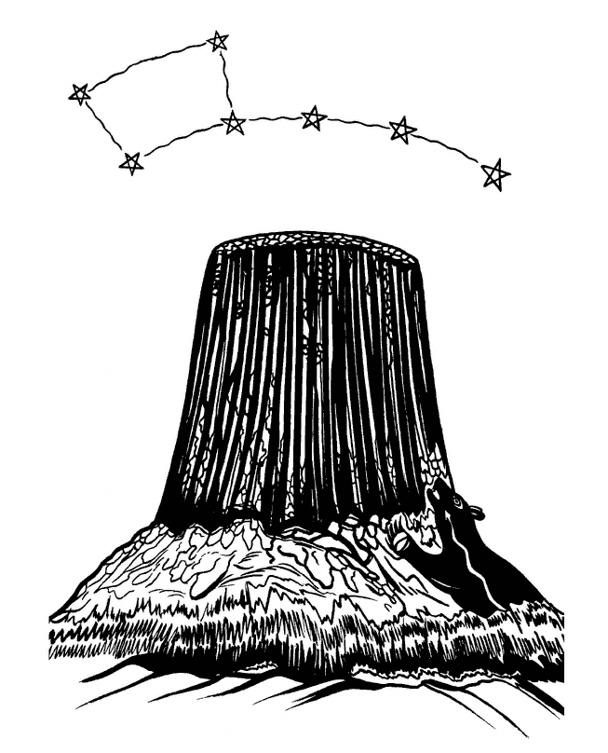
Other tribes had variations on the sibling motif, including the Blackfoot people who tell a story about boys who were neglected orphans. Their mistreatment led to divine retribution by the Sun Man.
The Kiowa tell a story of seven sisters who were fleeing bears. They climbed a rock to escape the bears but the bears kept coming so they prayed to the rock to rise up. The rock kept doing so and became what we now know as Devils Tower, and the sisters became stars (in some versions Pleaides, in others Ursa Major --- as depicted in the picture to the left)
Other tribes with sibling stories about the Pleiades include the Lakota and Pawnee nations, as well as the tribes of the Pacific coast.
Illustration from The Way to Rainy Mountain
by M. Scott Momaday, illustration by Al Momaday

Slide 12
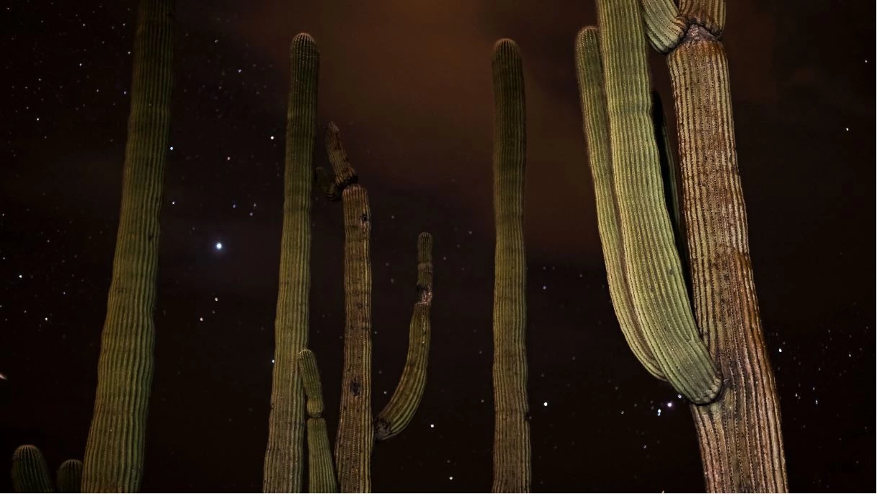
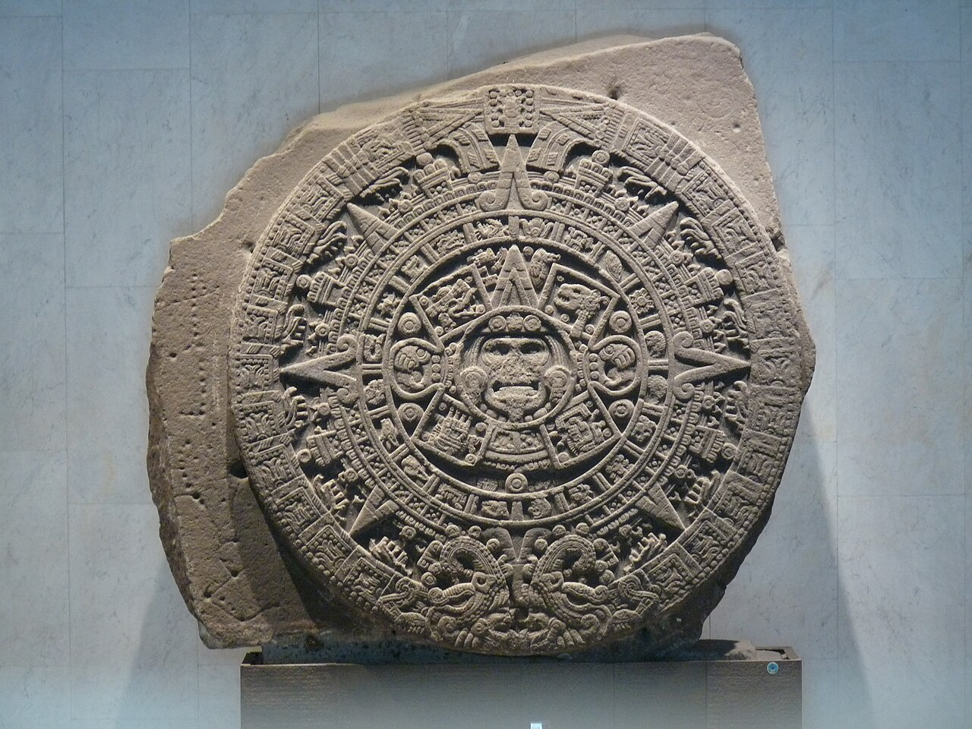
Other relatives come up in these Pleiades origin stories too, with one of the most interesting being from the O’odham people, in which, instead of siblings, the story is about wives who refuse to work and want to continue puberty celebrations non-stop.
And finally, many tribes (but especially those in Central and South America) understand the Pleiades primarily as markers of time, often associating the constellation with agricultural activities that traditionally occur when it first appears and later disappears in the night sky.
One example is that of the Aztecs, who began their year when the priests first observed the Pleiades rising in the east.

Slide 13
Comparisons and Conclusions
The oldest Jewish texts about the constellations are likely remnants of older stories from the people’s polytheistic past, but what got written down places the older myths in a new monotheistic context. The texts provide both an explanation for what people were seeing in the sky, but also served a communal purpose: to undermine prior polytheistic understandings (in other words, the god depicted in the texts has supremacy over the previously-deified constellations)
The Cherokee story (and the similar Indigenous American stories) also explains what people were seeing in the night sky, but also served social purposes such as encouraging hard work and communal values, as well as connecting the people to the geographic locations with cultural significance (i.e. the memorial pine of the Cherokees, Devil’s Tower for the Kiowa and Lakota, etc.).

Slide 14
Sources:
Andrews, Munya The Seven Sisters of the Pleiades (Spinafex, 2004)
Bark, Lindsey "Chunkey: A Game of Stones" Cherokee Phoenix (August 27, 2020) online at: https://www.cherokeephoenix.org/culture/chunkey-a-game-of-stones/article_cdca67ea-6e61-5457-9309-500d1c95183f.html
"Book of Amos" Wikipedia online at: https://en.wikipedia.org/wiki/Book_of_Amos
"Book of Job" Wikipedia online at: https://en.wikipedia.org/wiki/Book_of_Job
Branum, James M. "Pleaides in the Jewish textual tradition" Sefaria, online at: https://www.sefaria.org/sheets/694032.2?lang=bi&with=all&lang2=en
Chowdhury, Rohini "The Pleiades and the Pine Tree," online at: https://www.longlongtimeago.com/once-upon-a-time/myths/myths-of-the-cherokee/the-pleiades-and-the-pine-tree
Ignacio, Susanne, Enos Dean and Lucille Saxton O'Odham Legends and Lore (1969)
Kracht, Benjamin R. Kiowa Belief and Ritual (U. of Nebraska Press, 2017)

Slide 15
Continued Sources:
Miller, Courtney "Native American Skies: Cherokee - What the stars are made of" online at: https://nativeamericanantiquity.blogspot.com/2012/11/native-american-skies-cherokee-what.html?m=1
Miller, Courtney "Native American Skies- The Pleiades" online at: https://courtneymillerauthor.wordpress.com/category/chunkey-cherokee-iroquois-onandaga-pleiades-ani-tsutsa-oot-kwa-tah-dancing-in-the-sky/
Momaday, M. Scott The Way to Rainy Mountain (U. of New Mexico Press, 1998)
"Pleiades" online at: https://www.nativehistoryassociation.org/pleiades.php
"Pleiades" online at: https://en.wikipedia.org/wiki/Pleiades
"Pleiades in folklore and literature" Wikipedia online at: https://en.wikipedia.org/wiki/Pleiades_in_folklore_and_literature
Smallwood, Josh "The Boys: A Cherokee Story of The Pleiades" ChumashScience online at: https://chumashscience.com/2023/04/17/the-boys-a-cherokee-story-of-the-pleiades/

Slide 16
Continued Sources:
"Talmud" Wikipedia online at: https://en.wikipedia.org/wiki/Talmud
Webb, Mike "Origin of the Pleiades and the pine or the boys" online at: https://www.cherokeesofnortherncentralvalley.org/featured/origin-of-the-pleiades-and-the-pine-or-the-boys
Pictures used in this presentation are from either the articles above or from:
https://en.wikipedia.org/wiki/Temple_menorah#/media/File:Monnaie_-_Prutah,_bronze,_J%C3%A9rusalem,_Jud%C3%A9e,_Mattathias_Antigonos_-_btv1b8480202s_(1_of_2).jpg
https://en.wikipedia.org/wiki/Chunkey#/media/File:Chunkey_player_figurine.jpg
https://en.wikipedia.org/wiki/Blackfoot_Confederacy#/media/File:Flag_of_the_Blackfoot_Confederacy.jpg
https://www.worldhistory.org/image/18304/chunkey-player-flint-clay-figurine-from-cahokia/
https://en.wikipedia.org/wiki/Flag_of_the_Cherokee_Nation#/media/File:Flag_of_the_Cherokee_Nation.svg
https://starwalk.space/en/news/m45-pleiades-star-cluster
https://en.wikipedia.org/wiki/Iroquois#/media/File:Flag_of_the_Iroquois_Confederacy.svg
https://news.uark.edu/articles/68031/archeological-survey-and-caddo-nation-rename-saltworks-site
https://en.wikipedia.org/wiki/Aztec_sun_stone#/media/File:Monolito_de_la_Piedra_del_Sol.jpg
https://www.nps.gov/sagu/learn/nature/dark-sky.htm

